Slide 1
Introduction to backend development
I4GIC

Slide 2
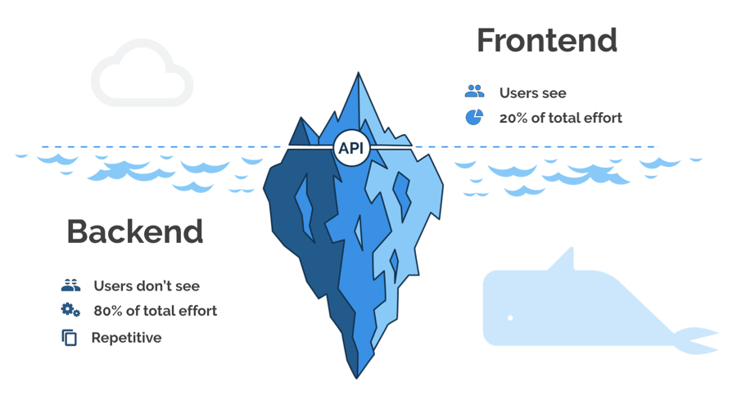

Slide 3
Why learn a backend programming language?
A backend programming language’s work is to handle the ‘behind the scenes’ functionality of Web applications.
Here are some of benefits of backend development:
Faster Information Sharing
Functions in Various Environments
Affects the User Experience of the Website
Data centralization

Slide 4
Top 10 backend languages
Backend language | Description | Popular Apps
Java | A high-level, object-oriented, class-based back-end language created to have as few implementation dependencies as possible. | Spotify Twitter Cash App
Ruby | It is a general-purpose, high-level, and interpreted backend language. | AirBnb Twitch Crazy Egg
Python | It is a high-level, object-oriented, interpreted backend language with dynamic semantics. | Reddit Quora Dropbox
PHP | It is a general-purpose scripting language mainly designed for web development. | Wikipedia MailChimp iStockPhoto
SQL | It is a domain-specific language utilized in programming and created to handle data in an RDMS. | Postgres SLQ Server MySQL

Slide 5
Backend language | Description | Popular Apps
JavaScript | Is a structured interpreted programming language, high-level script with dynamic typing and multiparadigm. | Netflix Uber Facebook
Rust | It is a multi-paradigm backend language created for performance and safety, particularly safe concurrency. | One Signal OVH 10x Genomics
C/C++ | It is a general-purpose, procedural backend programming language holding structured programming, recursion, and lexical variable scope. | Adobe Photoshop Firefox Bloomberg
NodeJS | It is an open-source JavaScript runtime. | PayPal eBay Godaddy
Solidity | It is an object-oriented backend language for writing smart contracts on the Ethereum blockchain. | Uniswap Dark Forest CoinBase Wallet

Slide 6
Handle requests and manipulate response accordingly
Client Side
Frontend
Storing, retrieving, deleting or update data

Slide 7
Skill sets requried to become a backend developer

Slide 8
server
Backend required Server (computer which is running almost all the time) to store, process data and serve to any user’s request.
Server requires software to become web server. You have multiple options:
Apache : most widely used web server. It is free and open source
Nginx
Microsoft IIS
Google Cloud
AWS ……

Slide 9
server
Be able to set up web server is still not enough to become server engineer. You are required more skills to be a qualified one:
Security Analysis/Protection
Backup/Restore
Auto deployment / Rollback
Encryption
Task Scheduler, Command script , ….
That why there is another job position just for this, the DevOps Engineer

Slide 10
Database and cache
Every programming language has standard support for Database Management System (DBMS) technology.
Data is a very important part of backend development, so there are many Database Management Systems such as :
MySQL,
Oracle,
SQLServer,
MongoDB, etc … are used to manage the data.
Database design, query design with effective performance is a necessary skill.

Slide 11
Api (rest & soap)
Web site or web app can be built as:
Client Side Rendering
Server Side Rendering
If CSR is used, API (Application Programming Interface) is a must for development. APIs allow client app to connect with backend apps with a fast/cost effective and secured manner.
SOAP (Simple Object Access Protocol) on another hand is a protocol that allow client to communicate with backend. You can see more detail here

Slide 12
Programming language
Be able to write code is a must for backend developer. While front-end developer focus on the UX/UI, Backend Deverloper focus on:
Security (infrastructure and data)
Performance
Cost on infrastructure
Migration and adaptability.

Slide 13
Backend Developer’s tasks
Here are some actual tasks for backend developer to work on:
Choose and Design database
Define access pattern from front-end (what kind of data/format that front-end developer might need)
Build and deploy database
Define routing which allow front-end developer to access (API URL)
Define pages to render UI (in case you are using SSR)
Define security measure to protect your server as well as the data (authentication, encryption, throttle ..)
Backup/Restore for further protection …

